Slide 1
webFCM-topics message
Topic messaging
https://firebase.google.com/docs/cloud-messaging/js/topic-messaging

Slide 2
Send multiple
How to send cloud message to multiple browser?

Slide 3
Topic messaging
1.Subscribe the client app to a topic
2.Send message

Slide 4
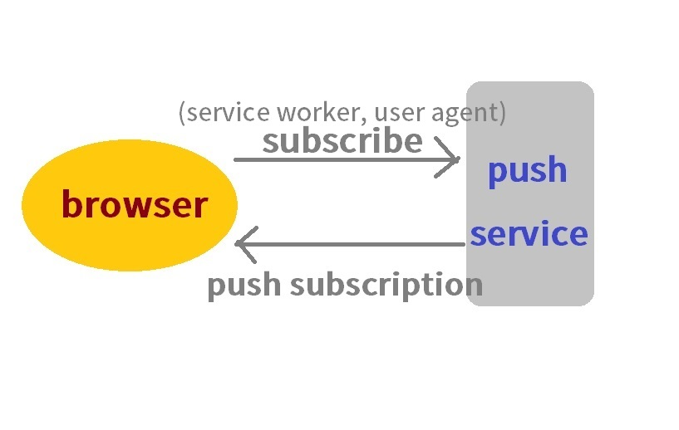
FCM work Flow

Slide 5
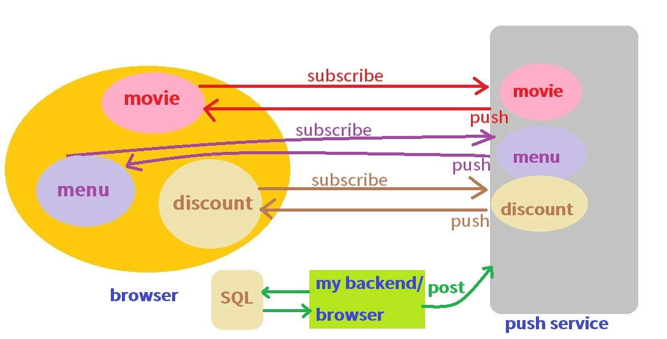
Topic messaging-My personal opinion

Slide 6
Topic messaging
1.Subscribe the client app to a topic
POST https://iid.googleapis.com/iid/v1/<REGISTRATION_TOKEN>/rel/topics/<TOPIC_NAME>
--Reference file
https://developers.google.com/instance-id/reference/server#create_relationship_maps_for_app_instances

Slide 7
Example-- 1.Subscribe the client app to a topic
var key = 'YOUR_API_KEY';
fetch(`https://iid.googleapis.com/iid/v1/IID_TOKEN/rel/topics/TOPIC_NAME`, {
'method': 'POST',
'headers': {
'Authorization': 'key=' + key,
'Content-Type': 'application/json'
},
}).then(function(response) {
console.log(response);
}).catch(function(error) {
console.error(error);
})

Slide 8
Topic messaging
2.Send message
POST https://fcm.googleapis.com/fcm/send
--Reference file
https://developers.google.com/instance-id/reference/server#create_relationship_maps_for_app_instances
Example POST request

Slide 9
Example-- 2.send message
var key = 'YOUR_API_KEY';
var notification = {
'title': 'Portugal vs. Denmark',
'body': '5 to 1',
'icon': 'firebase-logo.png',
'click_action': 'http://www.google.com.tw/'
};
fetch('https://fcm.googleapis.com/fcm/send', { //https://iid.googleapis.com/iid/v1:batchAdd
'method': 'POST',
'headers': {
'Authorization': 'key=' + key,
'Content-Type': 'application/json'
},
'body': JSON.stringify({
'notification': notification,
'to': "/topics/TOPICS_NAME",
"registration_tokens":
[ "IID_TOKEN", "IID_TOKEN"]
})
}).then(function(response) {console.log(response);
}).catch(function(error) { console.error(error);})

Slide 10
Batch Subscribe/cancel
BatchAdd
BatchRemove

Slide 11
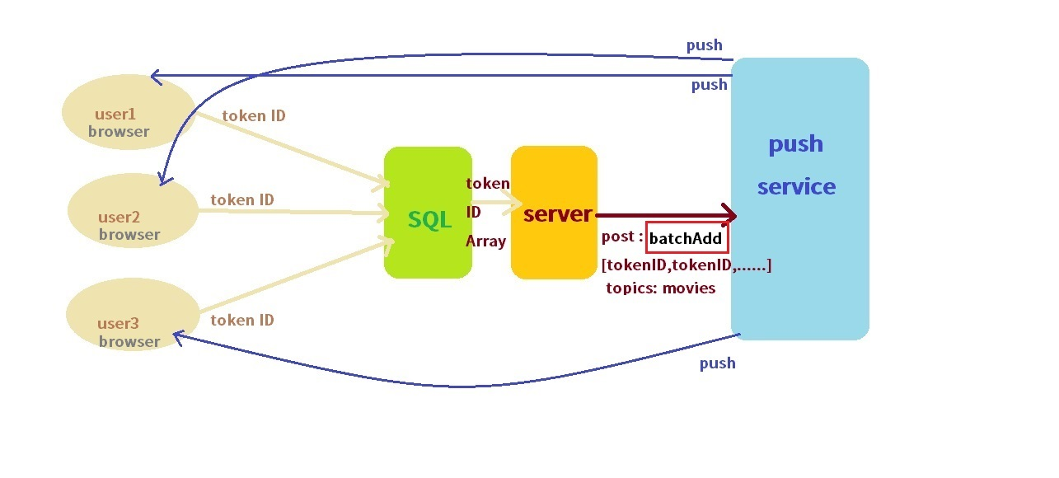
Batch Subscribe/cancel

Slide 12
Example-Batch Subscribe/cancel
var key = 'YOUR_API_KEY';
fetch('https://iid.googleapis.com/iid/v1:batchAdd', {
'method': 'POST',
'headers': {
'Authorization': 'key=' + key,
'Content-Type': 'application/json'
},
'body': JSON.stringify({
'to': "/topics/TOPICS_NAME",
"registration_tokens":
[ "IID_TOKEN", "IID_TOKEN" ]
})
}).then(function(response) {
console.log(response);
}).catch(function(error) {
console.error(error);
})

Slide 13
Safety
post api → FCM
The vdeio use browser just for example.
use backend to safty.
Don’t use browser to exposed api key.

Slide 14
Thank you

